Slide 1
\LaTeX
For Scientific Documentation
By Ammar Taha Mohamedy
Code Listing

Slide 2
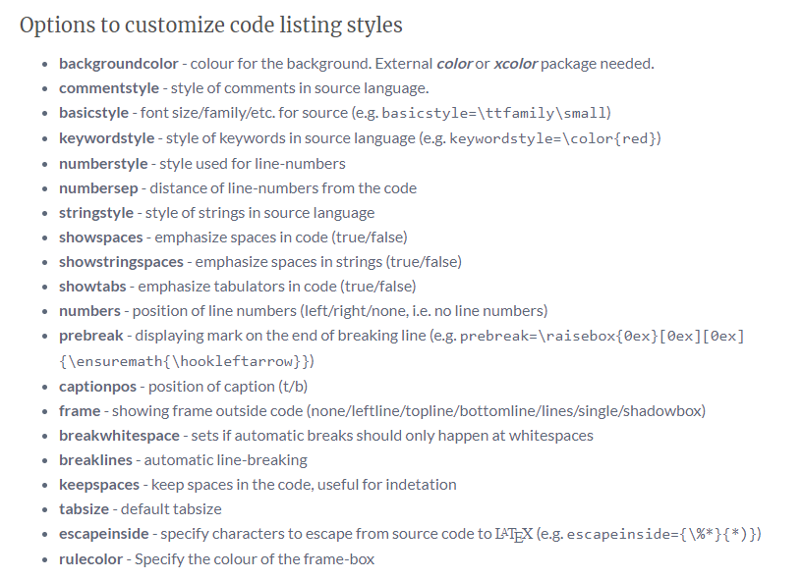

Slide 3
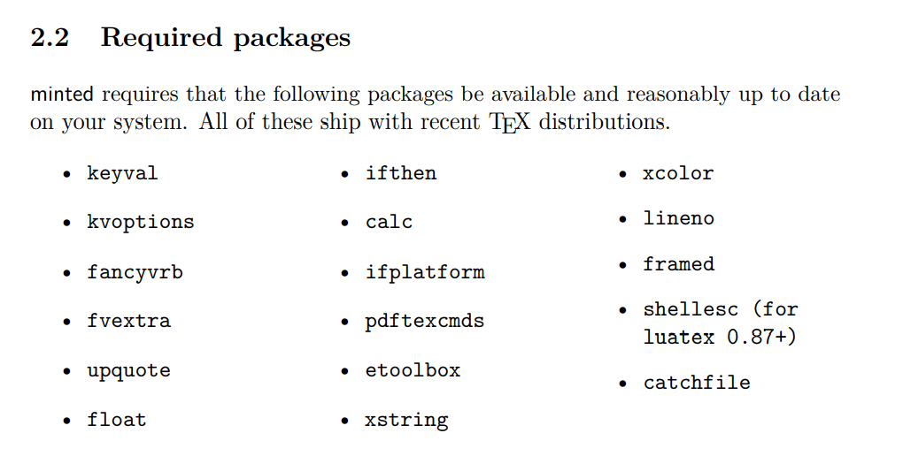

Slide 4
Thanks for Watching !!

